Slide 1
PHP
Part 2

Slide 2
Operators

Slide 3
Operators & Expressions
Operators are symbols used to:-
manipulate data stored in variables
make it possible to use one or more values to produce a new value
check the validity of data to determine the next step in a condition, and so forth.
A value operated on by an operator is referred to as an operand.
An operator is a symbol or series of symbols that, when used in conjunction with values, performs an action, and usually produces a new value.
An operand is a value used in conjunction with an operator. There are usually two or more operands to one operator.

Slide 4
x = 4 + 5
Expression : operator, constant, variables, functions call
Expressions
Operands
Operands
Operators

Slide 5
Assignment Operators
The assignment operator consists of the single character: =.
The assignment operator takes the value of the right-side operand and assigns it to the left-side
operand:
$name = “Jimbo”;
The assignment operator always resolves to a copy of the value of the right operand.
echo $name = “Jimbo”;

Slide 6
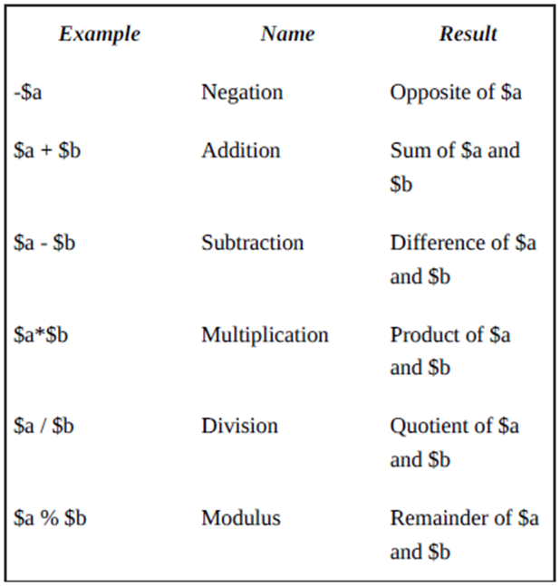
Arithmetic Operation
The arithmetic operators - do exactly what you would expect—they perform arithmetic operations.

Slide 7
Combined Assignment Operators
PHP provides a number of combination operators that transform the left-side operand and return a result while also modifying the original value of the variable.
Combined assignment operator consists of a standard operator symbol followed by an equal sign.
Ex 1: $x = 4;
$x = $x + 4; // $x now equals 8
Ex 2: $x = 4;
$x += 4; // $x now equals 8

Slide 8
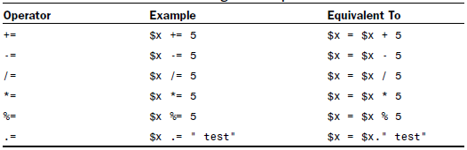

Slide 9
Concatenation Operator
The concatenation operator is represented by a single period (.).
Treating both operands as strings, this operator appends the right-side operand to the left-side operand.
“hello”.” world”
“hello”.”world”
Regardless of the data types of the operands used with the concatenation operator, they are treated as strings, and the result is always of the string type.
$cm = 212;
echo “the width is “.($cm/100).” meters”;

Slide 10
Incrementing and Decrementing an Integer Variable
When coding in PHP, you will often find it necessary to increment or decrement a variable that is an integer type.
You usually need to do this when you are counting the iterations of a loop.
$x = $x + 1; // $x is incremented by 1
$x += 1; // $x is incremented by 1
post-increment and post-decrement operators
$x++; // $x is incremented by 1
$x--; // $x is decremented by 1

Slide 11
In some circumstances, you might want to increment or decrement a variable in a test expression before the test is carried out.
PHP provides the pre-increment and predecrement operators for this purpose.
++$x; // $x is incremented by 1
--$x; // $x is decremented by 1
Example 1
$x = 3;
++$x < 4; // false

Slide 12
Comparison Operators
Comparison operators perform comparative tests using their operands and return the Boolean value true if the test is successful or false if the test fails.
This type of expression is useful when using control structures in your scripts, such as if and while statements.
$x < 5

Slide 13
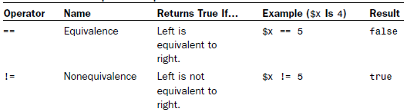
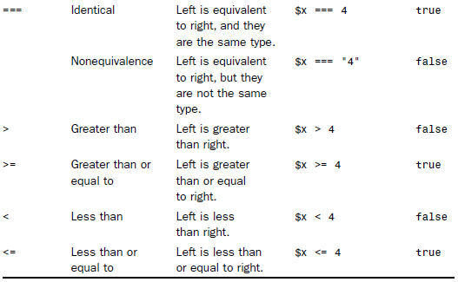

Slide 14
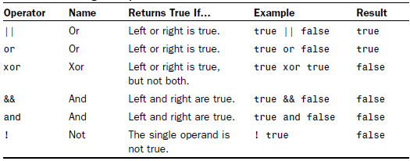
Logical Operators
Logical operators test combinations of Boolean values. For example, the or operator, which is indicated by two pipe characters (||) or simply the word or, returns the Boolean value true if either the left or the right operand is true:
true || false //returns true.

Slide 15
Operator Precedence
The PHP engine usually reads your expression from left to right.
4 + 5
4 + 5 * 2
Whatever the precedence of the operators in a complex expression, it is a good idea to use parentheses to make your code clearer and to save you from bugs such as applying sales tax to the wrong subtotal in a shopping cart situation.

Slide 16
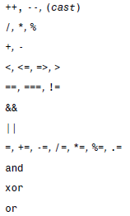

Slide 17
Constants
Variables offer a flexible way of storing data because you can change their values.
However, if you want to work with a value that must remain unchanged throughout your script’s execution, you can define and use a constant.
You must use PHP’s builtin define()function to create a constant, which subsequently cannot be changed unless you specifically define() it again.
To use the define() function, place the name of the constant and the value you want to give it within parentheses and separated by a comma:
define(“YOUR_CONSTANT_NAME”, 42);

Slide 18
<?php
define(“THE_YEAR”, “2012”);
echo “It is the year “.THE_YEAR;
?>

Slide 19
Exercise
Assign values to two variables. Use comparison operators to test whether the first value is
The same as the second
Less than the second
Greater than the second
Less than or equal to the second
Print the result of each test to the browser.
Change the values assigned to your test variables and run the script again.

Slide 20
Flow Control Function

Slide 21
Switching Flow
It is common for scripts to evaluate conditions and change their behaviour accordingly.
These decisions are what make your PHP pages dynamic.
PHP enables you to do this with an if statement.

Slide 22
The if Statement
The if statement is a way of controlling the execution of a statement that follows it.
The if statement evaluates an expression found between parentheses.
If this expression results in a true value, the statement is executed. Otherwise, the statement is skipped entirely.
if (expression) {
// code to execute if the expression evaluates to true
}

Slide 23
Ex 1: if statement
1: <?php
2: $mood = “happy”;
3: if ($mood == “happy”) {
4: echo “Hooray! I’m in a good mood!”;
5: }
6: ?>
Now try to add another if statement if mood is sad. Please print “I need a break!”.

Slide 24
The if…else Statement
When working with an if statement, you might want to define an alternative block of code that should be executed if the expression you are testing evaluates to false.
if (expression) {
// code to execute if the expression evaluates to true
} else {
// code to execute in all other cases
}

Slide 25
Ex 2: if…else
1: <?php
2: $mood = “sad”;
3: if ($mood == “happy”) {
4: echo “Hooray! I’m in a good mood!”;
5: } else {
6: echo “I’m in a $mood mood.”;
7: }
8: ?>
What is the output?

Slide 26
if…else if…else Statement
You can use an if...elseif...else clause to test multiple expressions (the if...else portion) before offering a default block of code.
if (expression) {
// code to execute if the expression evaluates to true
} elseif (another expression) {
// code to execute if the previous expression failed
// and this one evaluates to true
} else {
// code to execute in all other cases
}

Slide 27
Ex 3: if…else if…else
1: <?php
2: $mood = “sad”;
3: if ($mood == “happy”) {
4: echo “Hooray! I’m in a good mood!”;
5: } elseif ($mood == “sad”) {
6: echo “Awww. Don’t be down!”;
7: } else {
8: echo “I’m neither happy nor sad, but $mood.”;
9: }
10: ?>

Slide 28
switch Statement
The switch statement is an alternative way of changing flow, based on the evaluation of an expression.
Using the if statement in conjunction with elseif, you can evaluate multiple expressions, as you’ve just seen.
However, a switch statement evaluates only one expression in a list of expressions, selecting the correct one based on a specific bit of matching code.

Slide 29
switch Syntax
switch (expression) {
case result1:
// execute this if expression results in result1
break;
case result2:
// execute this if expression results in result2
break;
default:
// execute this if no break statement
// has been encountered hitherto
}

Slide 30
Ex 4: switch
1: <?php $mood = “sad”;
3: switch ($mood) {
4: case “happy”:
5: echo “Hooray! I’m in a good mood!”;
6: break;
7: case “sad”:
8: echo “Awww. Don’t be down!”;
9: break;
10: default:
11: echo “I’m neither happy nor sad, but $mood.”;
12: break; } ?>

Slide 31
Loops

Slide 32
Loops
Scripts can also decide how many times to execute a block of code.
Loop statements are specifically designed to enable you to perform repetitive tasks because they continue to operate until a specified condition is achieved or until you explicitly choose to exit the loop.

Slide 33
The while Statement
The while statement looks similar in structure to a basic if statement, but has the ability to loop:
while (expression) {
// do something
}
Within the block, you usually change something that affects the while statement’s expression; otherwise, your loop continues indefinitely.

Slide 34
Ex 1: while loop
1: <?php
2: $counter = 1;
3: while ($counter <= 12) {
4: echo $counter.” times 2 is “.($counter * 2).”<br />”;
5: $counter++;
6: }
7: ?>

Slide 35
The do…while Statement
The essential difference between the two is that the code block is executed before the truth test and not after it:
do {
// code to be executed
} while (expression);
Useful when you want the code block to be executed at least once, even if the while expression evaluates to false.
; is a must!

Slide 36
Ex 2: do…while loop
1: <?php
2: $num = 1;
3: do {
4: echo “The number is: “.$num.”<br />”;
5: $num++;
6: } while (($num > 200) && ($num < 400));
7: ?>

Slide 37
The for Statement
With a for statement, you can achieve this same series of events, but in a single line of code.
This allows for more compact code and makes it less likely that you might forget to increment a counter variable, thereby creating an infinite loop:
for (initialization expression; test expression; modification expression) {
// code to be executed
}
semicolon

Slide 38
Ex 3: for loop
1: <?php
2: for ($counter=1; $counter<=12; $counter++) {
3: echo $counter.” times 2 is “.($counter * 2).”<br />”;
4: }
5: ?>

Slide 39
Flow Control Exercise
1. How do you use an if statement to print the string “Youth message” to the browser if an integer variable, $age, is between 18 and 35? If $age contains any other value, the string “Generic message” should be printed to the browser.
2. How do you extend your code in question 1 to print the string “Child message” if the $age variable is between 1 and 17?
3. How do you create a while statement that increments through and prints every odd number between 1 and 49?
4. How do you convert the while statement you created in question 3 into a for statement?

